Slide 1
BOOKING A DOCTOR USING MERN
TEAM MEMBERS
KAVEEN VIGNESH T K (211521205063)
KELVIN ABISHEK B (211521205065)
KARTHICK S (211521205061)
KETHINENI HARI (211521205066)

Slide 2
ABSTRACT
In today's fast-paced world, efficient healthcare delivery has become paramount. The Doctor Appointment System aims to bridge the gap between patients and healthcare providers by streamlining the appointment scheduling process. Traditional methods of booking appointments, such as phone calls and in-person visits, can lead to long wait times, scheduling conflicts, and a lack of accessibility. This project seeks to provide a user-friendly platform that allows patients to easily search for and book appointments with doctors of various specialties. By leveraging technology, the system enhances patient experience, optimizes doctors' schedules, and ultimately improves healthcare access. The platform incorporates essential features such as user authentication, appointment management, and feedback mechanisms, all while ensuring data security and privacy. This innovative solution not only facilitates better communication between patients and doctors but also sets the stage for potential future enhancements, including telemedicine services and mobile accessibility. Through this project, we aim to create a comprehensive digital solution that addresses the challenges of healthcare accessibility, providing a seamless experience for both patients and healthcare providers.

Slide 3
INTRODUCTION
The Doctor Appointment System is a web-based application designed to facilitate efficient scheduling and management of medical appointments between patients and healthcare providers. This system addresses the challenges associated with traditional appointment booking methods, such as long wait times, miscommunication, and difficulty in accessing medical services. By offering a user-friendly interface, patients can easily search for doctors by specialty, view availability, and book appointments at their convenience. The application is built with a robust backend that ensures secure data handling and patient privacy while enabling real-time updates and notifications. Features such as user authentication, appointment reminders, and feedback mechanisms enhance user experience and foster improved communication between patients and doctors. This project not only streamlines the appointment process but also lays the groundwork for future enhancements, such as telehealth capabilities and mobile app integration. Ultimately, the Doctor Appointment System aims to improve healthcare accessibility, promote timely medical consultations, and contribute to better overall patient outcomes.

Slide 4
PROPOSED SYSTEM
User Roles and Authentication: Allows patients and doctors to securely create accounts and log in to access their respective features.
Appointment Scheduling: Allows patients to view available time slots and book appointments in real-time, avoiding scheduling conflicts.
Appointment Management: Lets patients view, cancel, or reschedule their appointments, while doctors can manage their schedules effectively.
Patient Records: Stores essential patient information, including medical history and past appointments, for easy access by doctors.
Future Enhancements: Potential features include telemedicine integration, online payment processing, and mobile app development for enhanced user experience.

Slide 5
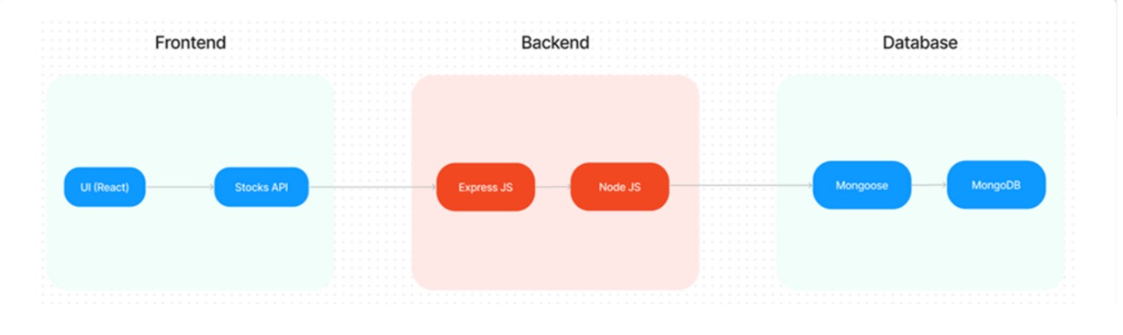
ARCHITECTURE DIAGRAM
The architecture consists of the following components:
Frontend (React.js): Manages user interface and client-side logic.
Backend (Node.js with Express): Handles server requests, business logic, and interactions with the database.
Database (MongoDB): Stores all data related to users, appointments, and authentication.
Authentication (JWT): Ensures secure access control by generating tokens during user login.

Slide 6
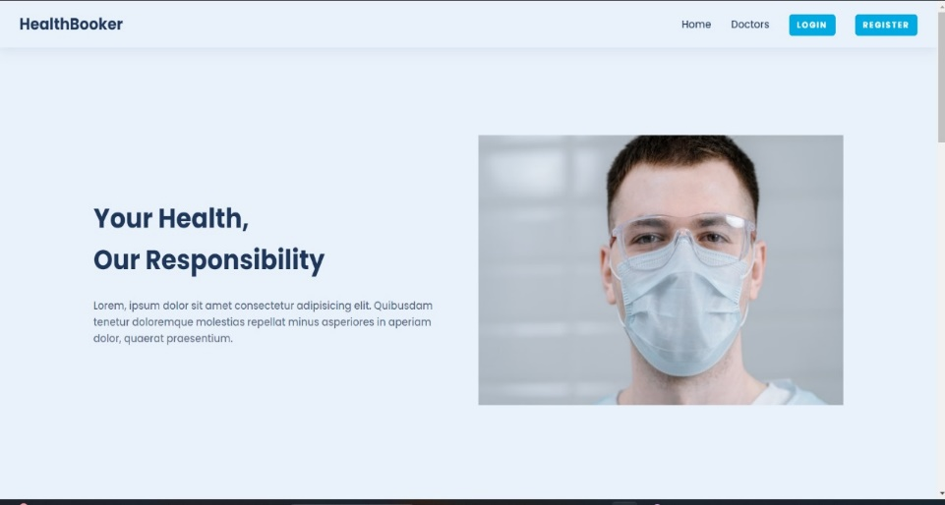
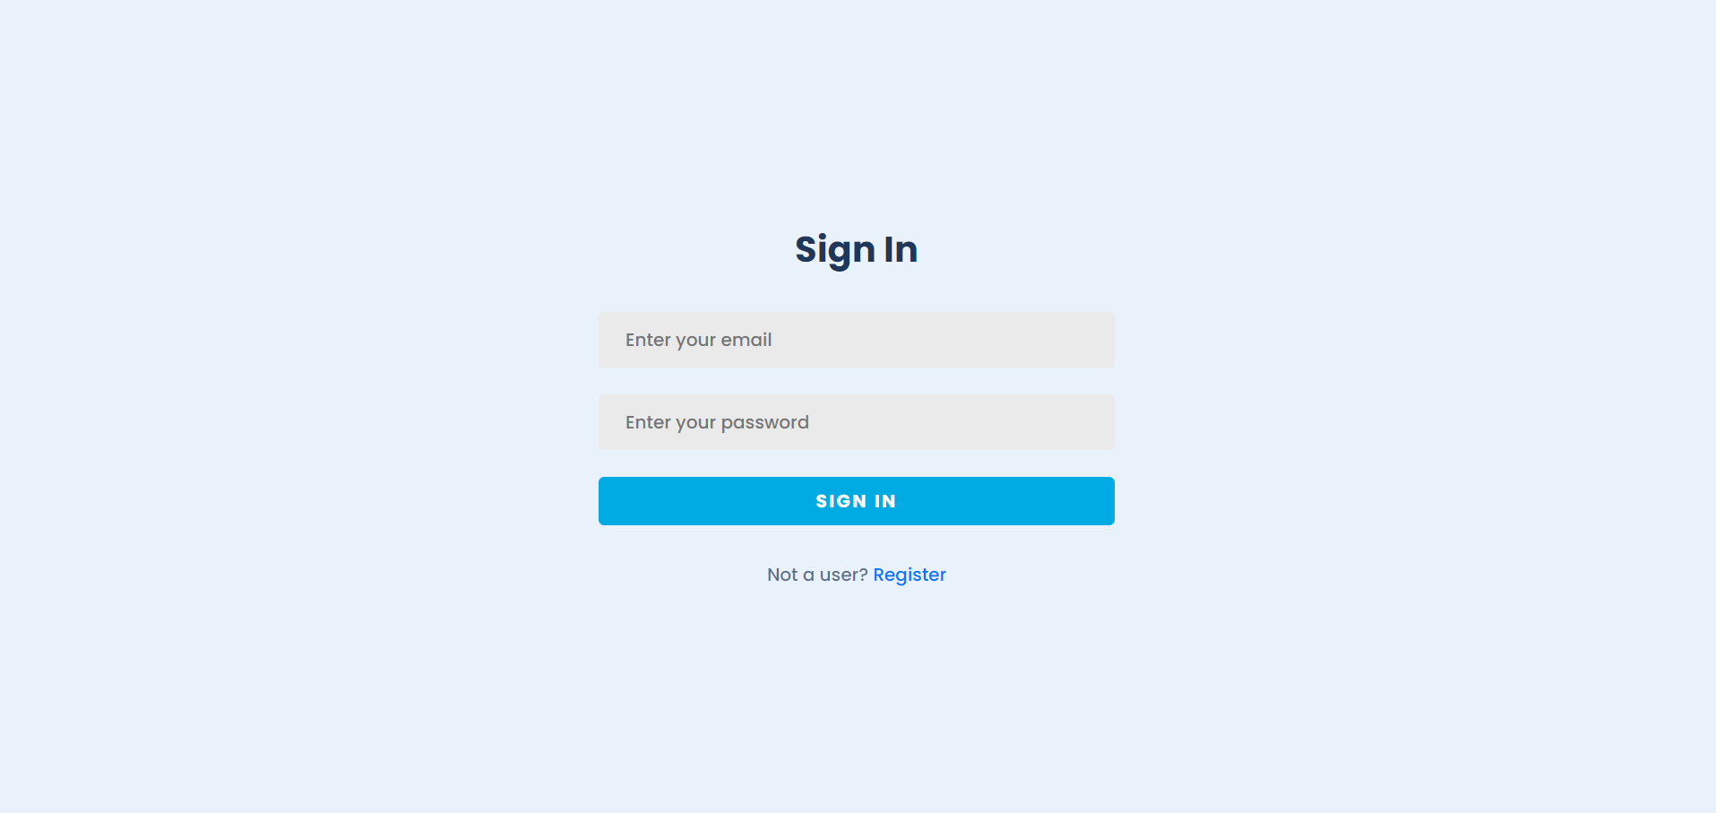
FRONTEND DEVELOPMENT
The frontend of the system is developed using React.js, providing a dynamic and responsive user interface. React Router was used to manage navigation across different pages, such as login, registration, and appointment scheduling. Components are modular, ensuring maintainability and reusability. The CSS framework was utilized for responsive design, making the system accessible across multiple devices, including mobile and tablet views. Future improvements in frontend design will focus on enhancing the user experience and incorporating visual elements like notifications and alerts.

Slide 7
BACKEND DEVELOPMENT
The backend of the Doctor Appointment System is developed using Node.js and Express.js, implementing a RESTful API to handle HTTP requests efficiently. It integrates with MongoDB through Mongoose, facilitating seamless data management for user profiles, appointments, and feedback.
Key features include user authentication with JSON Web Tokens (JWT) for secure access, comprehensive appointment management that ensures availability checks and notifications, and robust error handling for smooth operation. The backend also implements input validation to maintain data integrity, logging for activity tracking, and can be deployed on cloud platforms like Heroku or AWS for scalability. Overall, the backend provides a secure and efficient foundation for the application, ensuring reliable interaction with the frontend.

Slide 8
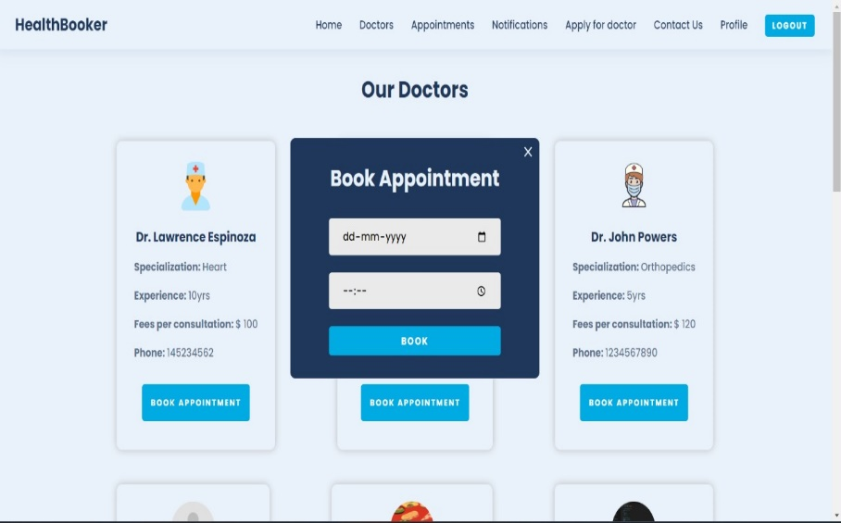
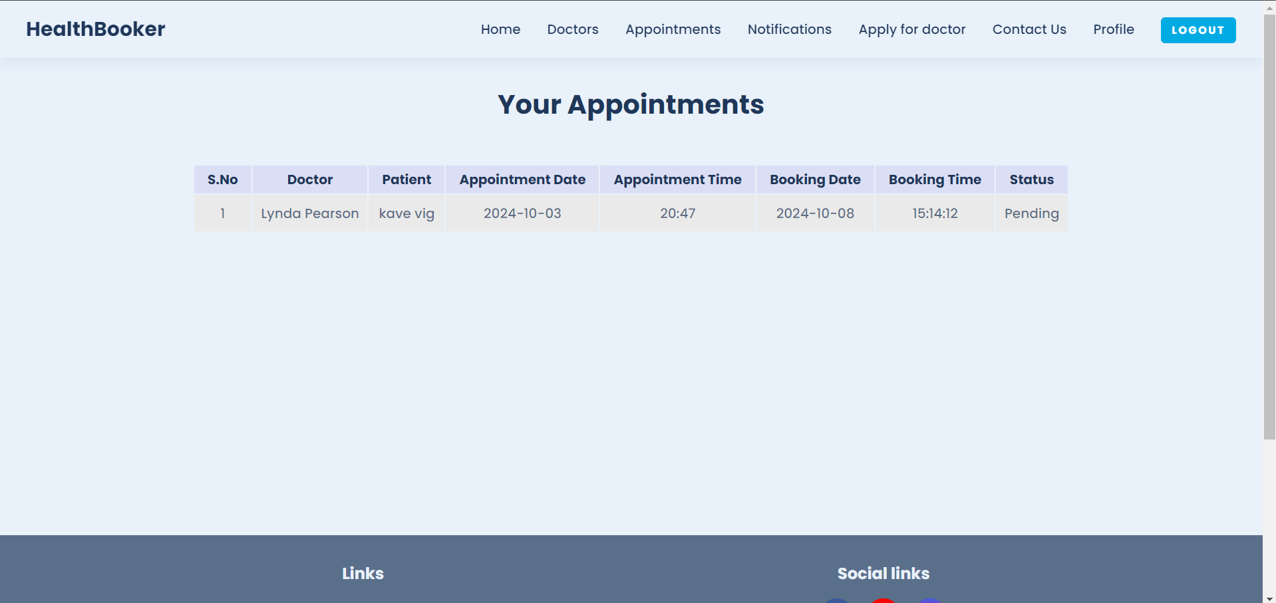
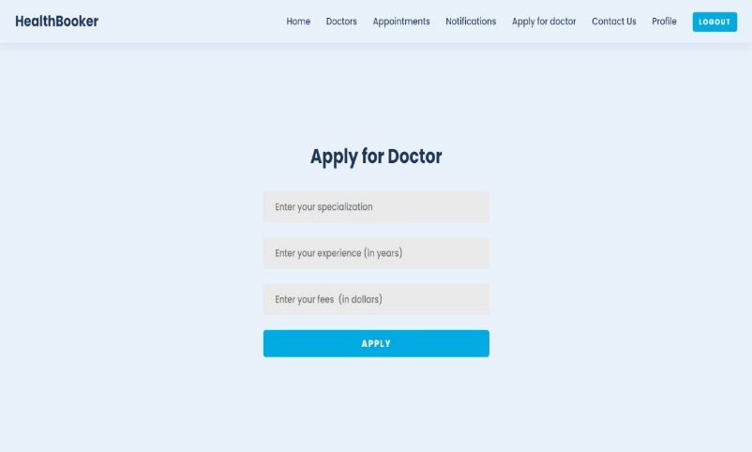
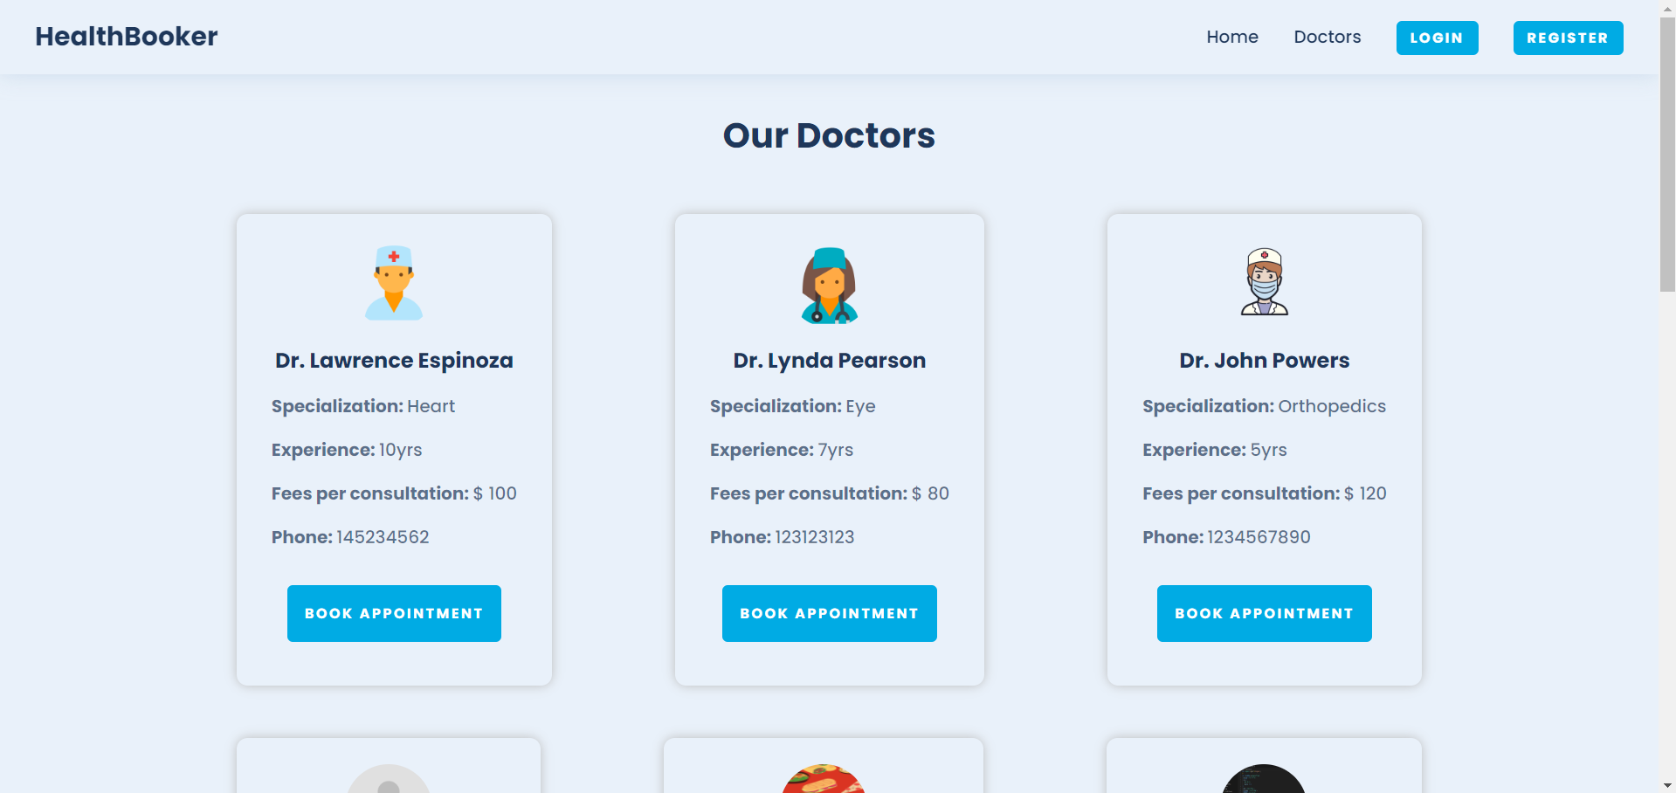
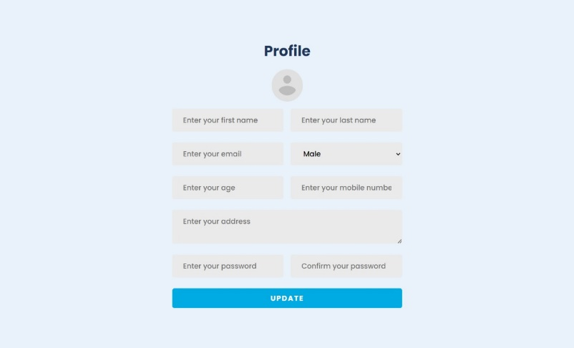
MODEL
Signin Page
Appointment Booking Page
My Appointment Page
Applying Doctor Page
Doctors Page
Profile Page

Slide 9
CONCLUSION
The Doctor Appointment System is a web-based platform developed to streamline the process of booking and managing appointments between patients and doctors. Built using Node.js for the backend, React for the frontend, and MongoDB for the database, the system offers secure user authentication through JWT and provides role-specific functionalities for both patients and doctors. Patients can easily book appointments, while doctors can manage their schedules in real-time. A significant challenge encountered during development involved the JWT configuration, which was resolved by correctly setting up environment variables and utilizing the dotenv package. The project effectively addresses appointment management needs and ensures secure handling of user data. Looking ahead, future enhancements could include features like notification systems, calendar synchronization, payment integration, and improved UI design, further enhancing its functionality and user experience.

Slide 10
THANK YOU

